Slide 1
5 Spatial Data Quality
5.1 Data Quality Information (DQI)
5.2 Accuracy, Precision, Bias
5.3 Error Modeling

Slide 2
Data Quality Information (DQI)

Slide 3
Spatial data quality category
Spatial Data quality can be categorized into
Data completeness
Data Precision
Data accuracy
Data Consistency.

Slide 4
Spatial data quality category
Data Completeness: It is basically the measure of totality of features. A data set with minimal amount of missing features can be termed as Complete-Data.
Data Precision: Precision can be termed as the degree of details that are displayed on a uniform space.
Data Accuracy: This can be termed as the discrepancy between the actual attributes value and coded attribute value.
Data Consistency: Data consistency can be termed as the absence of conflicts in a particular database.

Slide 5
Assessment of Data Quality
Data quality is assessed using different evaluation techniques by different users.
The first level of assessment is performed by the data producer. This level of assessment is based on data quality check based on given data specifications.
Second level of data quality assessment is performed at consumer side where feedback is taken from the consumer and processed. Then the data is analyzed / rectified on the basis of processed feedback.

Slide 6
Sources of Spatial Data Discrepancy
Data Information Exchange
Type and Source
Data Capture
Cartographic Effects
Data Transfer
Metadata

Slide 7
Sources of Spatial Data Discrepancy
Data Information Exchange
Data information exchange is basically the information about the data provided by the client to organization. The degree of information provided by the client defines the accuracy and completeness of data.
Type and Source
Data type and source must be evaluated in order to get appropriate data values. There are many spatial data formats and each one of them is having some beneficiary elements as well as some drawbacks. For example: In order to use CAD data on GIS platform, data must be evaluated and problems must be rectified otherwise resultant values will show the high extents of discrepancies. Conventional data formats are quiet specific to data storage technique and functional compatibilities. For example: Topology can not be created on shapefiles. This can be created only on the latest geospatial storage format- Geodatabase. So, data type and source must be identified and evaluated before proceeding towards any analysis.
Data Capture
There are many tools that incorporate manual skills to capture the data using various softwares like ArcGIS. These softwares allows user to capture information from the base data. During this data capture, the user may misinterpret features from the base data and captures the features with errors. For example: A user misinterprets two buildings as single building and capture as a single feature. But in real world, there are two features. So, the correct interpretation of features in base data must be performed. However, there are many tools that enables user to find and fix those errors, but still these tools are not used frequently due to lack of awareness. Data capture must be performed on a perfect scale where one must be able to view the features distinctly.

Slide 8
Sources of Spatial Data Discrepancy
Cartographic Effects
After capturing the data, some cartographic effects like symbology, pattern, colors, orientation and size are assigned to the features. This is required for a better representation of reality. These effects must be assigned according to the domain of the features. Like for Forestry application, forestry domain specific cartographic elements must be used. Elements of any other domain used for a particular domain degrades the output of results.
Data Transfer
Some discrepancies may occur while transferring the data from one place to another. For example: Data transferred from a web source to the standalone, web disconnected machine. Sometimes, In order to make the accurate data more accurate, user tries to apply different advanced rectification technique but as a result the less accurate data changes into highly degraded data. “There is no bad or good data. There are only data which are suitable for a specific purpose.” So, Data must be evaluated according to the domain for which it is supposed to be used.
Metadata
Sometimes metadata is not updated according to the original features. For example: Few features are edited on some software platform but the edited information is not updated like name of the editor, reason for editing and some more relevant information. So, metadata must be updated with the original data.

Slide 9
Identify data quality requirements
One of the challenges in implementing data quality control processes is the identification of technical data quality requirements for the organization.
It is important to identify and understand the business requirements for your data before translating those into technical requirements that define good-quality data.
An effective data quality control process is based on the understanding of how data and information products are used within and outside the organization.
Each organization defines quality differently and bases this definition on the intended purpose and use of the data.

Slide 10
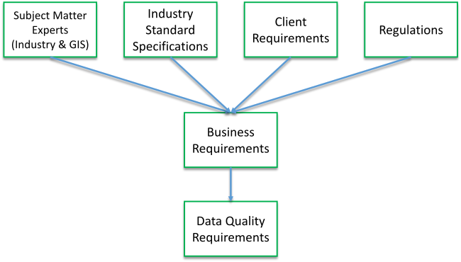
sources for quality requirements
The diagram illustrates a variety of sources for quality requirements that may be applicable to your organization.

Slide 11
Data quality elements
Data quality elements describe a certain aspect required for a dataset to be used and accurate.
GIS data has different components to its quality.
As defined by the International Organization for Standardization (ISO), these components include the following:
Completeness
Logical consistency
Spatial accuracy
Thematic accuracy
Temporal quality
Data usability

Slide 12
Completeness
The presence or absence of features, their attributes, and relationships in a data model.

Slide 13
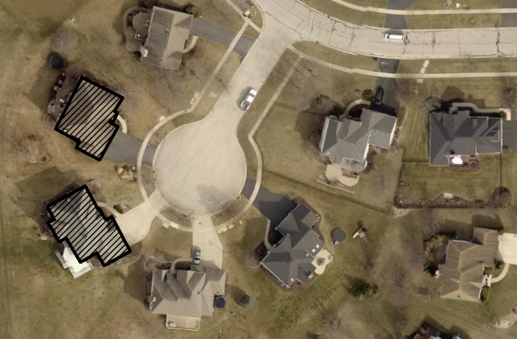
A neighborhood with missing building footprint.

Slide 14
Logical consistency
A degree of adherence to preestablished rules of a data model's structure, attribution, and relationships as defined by an organization or industry. Many industries follow standards that are reflected in a geospatial data model as value domains, data formats, and topological consistency of how the data is being stored.

Slide 15
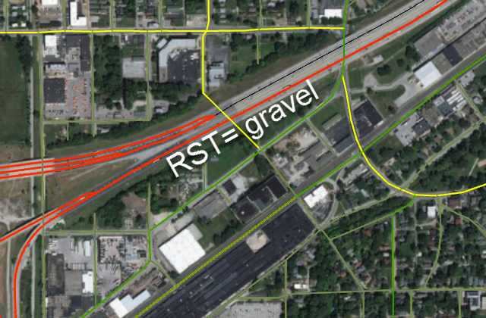
A highway with road surface-type gravel.

Slide 16
Spatial accuracy
The accuracy of the position of features in relation to Earth.

Slide 17
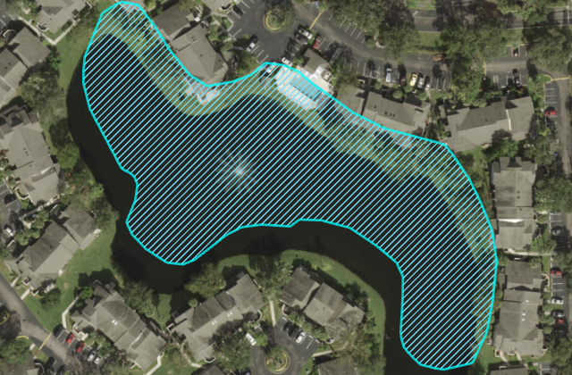
A lake feature that has been shifted.

Slide 18
Thematic accuracy
The accuracy of attributes within features and their appropriate relationships.

Slide 19
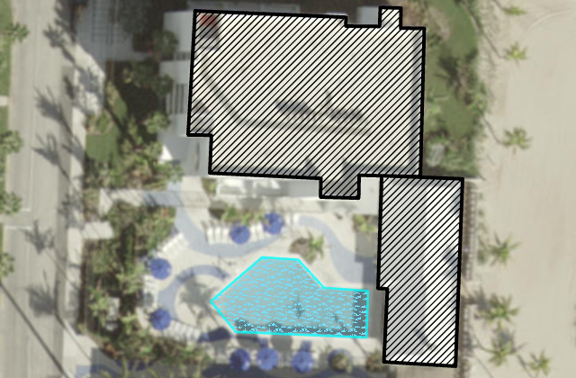
A swimming pool captured as wetland.

Slide 20
Temporal quality
The quality of temporal attributes and temporal relationship of features.

Slide 21
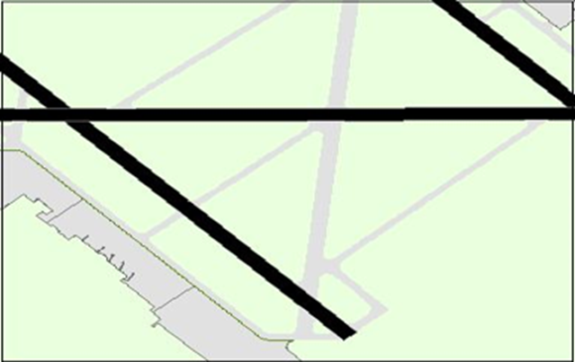
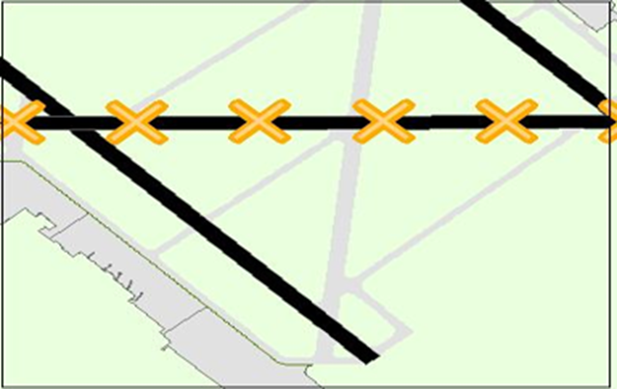
An outdated chart with open runway.
An outdated chart with open runway.
An updated chart with closed runway.

Slide 22
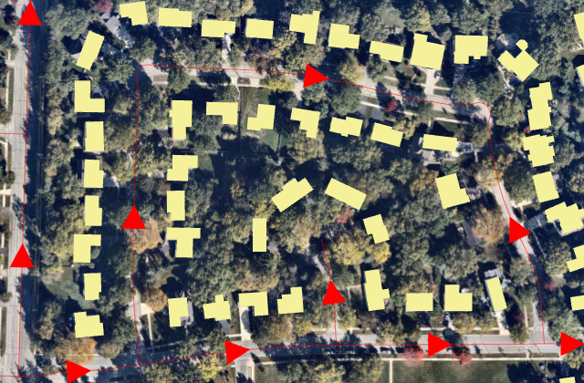
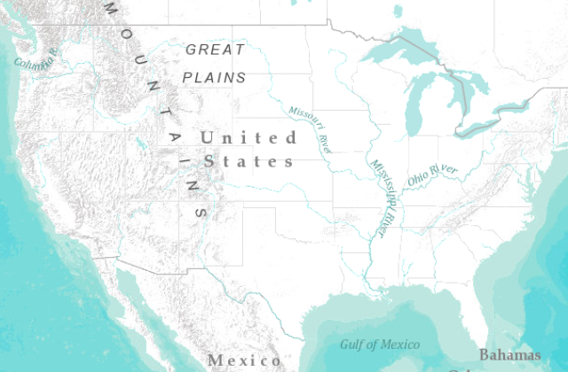
Data usability
Adherence of a dataset to a specific set of requirements related to a use-case.
This is used to map national parks.
This is used to route emergency vehicles.

Slide 23
Quality requirement documentation
A quality assurance (QA) plan is a document that identifies the quality standards that are relevant to a project and methods to achieve them.
A QA plan is a living document that will change as new quality requirements are identified by the organization and also serves as an opportunity to bring together key stakeholders to build a common picture of what constitutes good-quality data and the business processes that drive those requirements.

Slide 24
Quality requirement documentation
The following are documentation techniques and standards that can be useful when identifying data quality requirements:
ISO/TC 211 Geographic information/Geomatics—International Organization for Standardization (ISO) series of standards for geographic information to define methods, tools, and services for data management for acquiring, processing, analyzing, accessing, presenting, and transferring such data in digital form among users, systems, and locations.
Requirements Traceability Matrix—A document created to manage and track business requirements to ensure they are met during a project implementation. This document correlates business requirements collected for the project and capabilities of a software product.

Slide 25
Example
The Requirement Category column in the following table illustrates an example of collected requirements that reference some of the data quality elements outlined above.
The next step after organizing and categorizing your requirements will be to correlate data quality requirements to corresponding capabilities found in ArcGIS / QGIS.

Slide 26
Sample Requirements Traceability Matrix

Slide 27
ID | Requirement | Requirement category
1 | Ability to run queries based on number of segments edited by an individual user | Functional Requirement
2 | Ability to ensure the production data model is compliant with industry schema standard | Data Requirement—Logical consistency
3 | As geodatabase administrator, ability to restrict POST privileges to the DEFAULT version of a small set of admin users | Functional Requirement
4 | Ability to produce ad hoc reports indicating gaps in data for any attributes selected | Functional Requirement
5 | Ability to ensure that source data will be migrated into the production database and have appropriate domains and relationships | Data Requirement—Logical consistency

Slide 28
ID | Requirement | Requirement category
6 | Ability to ensure that source data is accurate according to the defined standards | Data Requirement—Spatial accuracy
7 | Ability to ensure that production data is for mobile collectors and is attribute accurate | Data Requirement—Thematic accuracy
8 | Ability to ensure that there is no overlap between event measures during the project period of 2010–2020 | Data Requirement—Temporal quality
9 | Ability to hyperlink a validation error with a violated business rule and provide a description | Functional Requirement
10 | Ability to identify the number of cells that are not populated (NULL) for each required attribute field | Data Requirement—Thematic accuracy

Slide 29
ID | Requirement | Requirement category
10 | Ability to identify the number of cells that are not populated (NULL) for each required attribute field | Data Requirement—Thematic accuracy
11 | Ability to identify parcels that have no overlaying building footprint features | Data Requirement—Logical consistency
12 | Ability to create error reports, generate Excel files, and save them to a local drive | Functional Requirement
13 | Ability to validate a unique ID attribute linking a parcel to matching building footprint features | Data Requirement—Logical consistency
14 | Ability to confirm all features are compliant with metadata standards | Data Requirement—Data completeness
15 | Ability to identify existing features as an error | Data Requirement—Thematic accuracy
16 | Ability to indicate the location of missing features as an error | Data Requirement—Data completeness

Slide 30
Accuracy, Precision, Bias

Slide 31
Accuracy and Precision
Accuracy and precision are both important aspects of GIS data quality, but they refer to different things.
In order to really understand the relevance of accuracy and precision, we should start getting the difference between both term.

Slide 32
Accuracy and Precision
Accuracy can be defined as the degree or closeness to which the information on a map matches the values in the real world. Therefore, when we refer to accuracy, we are talking about quality of data and about number of errors contained in a certain dataset.
In GIS data, accuracy can be referred to a geographic position, but it can be referred also to attribute, or conceptual accuracy.

Slide 33
Accuracy and Precision
Precision refers how exact is the description of data.
Precise data may be inaccurate, because it may be exactly described but inaccurately gathered.
(Maybe the surveyor made a mistake, or the data was recorded wrongly into the database).

Slide 34
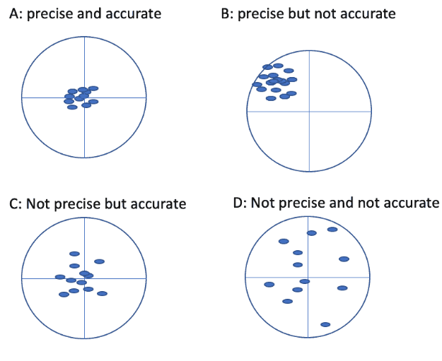
Precision versus Accuracy
In the series of images, the concept of precision versus accuracy is visualized. The crosshair of each image represents the true value of the entity and the red dots represent the measure values.

Slide 35
Precision versus Accuracy.
In the series of images, the concept of precision versus accuracy is visualized. The crosshair of each image represents the true value of the entity and the red dots represent the measure values.

Slide 36
Precision versus Accuracy
In the series of images, the concept of precision versus accuracy is visualized. The crosshair of each image represents the true value of the entity and the red dots represent the measure values.
Image A is precise and accurate, image B is precise but not accurate, image C is accurate but imprecise, Image D is neither accurate nor precise.
Understanding both accuracy and precision is important for assessing the usability of a GIS dataset. When a dataset is inaccurate but highly precise, corrective measures can be taken to adjust the dataset to make it more accurate.
Error involves assessing both the imprecision of data and its inaccuracies.

Slide 37
Sources of Inaccuracy and Imprecision
Some sources of error in GIS data are very obvious, whereas others are more difficult to notice.
GIS software can make the users to think that their data is accurate and precise to a degree that is not quite real.
Sorces
Scale of GIS Data
Age of GIS Data
GIS Data Formatting Errors

Slide 38
Errors
Attribute errors
Positional accuracy of GIS data
Topological errors
Intentional GIS data errors
Generalization of GIS data

Slide 39
Attribute errors
Quite often we can identify quantitative and qualitative errors.
A common mistake can happen with label or attribute errors.
For instance, an agricultural land may be incorrectly marked as a marsh, and this would cause an error that the map user may not notice because they may not be familiar with the area in question.
Quantitative errors may occur also when using instrument that have not been properly calibrated creating subsequent errors hard to identify in the field, but that will cause your project to lose accuracy and reliability.

Slide 40
Positional accuracy of GIS data
We also have to pay attention to what has been defined as positional accuracy, which is dependent on the type of data.
Cartographers can accurately locate certain features like roads, boundary lines, etc. but other data with less defined position in space such as soil types, may be just an approximate location based on the estimation of the cartographer.
Other features, like climate, for instance lack defined boundaries in nature and, therefore, are subject to subjective interpretation.

Slide 41
Topological errors
Topological errors occur often during the digitizing process.
Errors during digitization or creation of GIS data may result in polygon knots or weird polygons, and loops, and there may be some errors associated with damaged source maps as well.

Slide 42
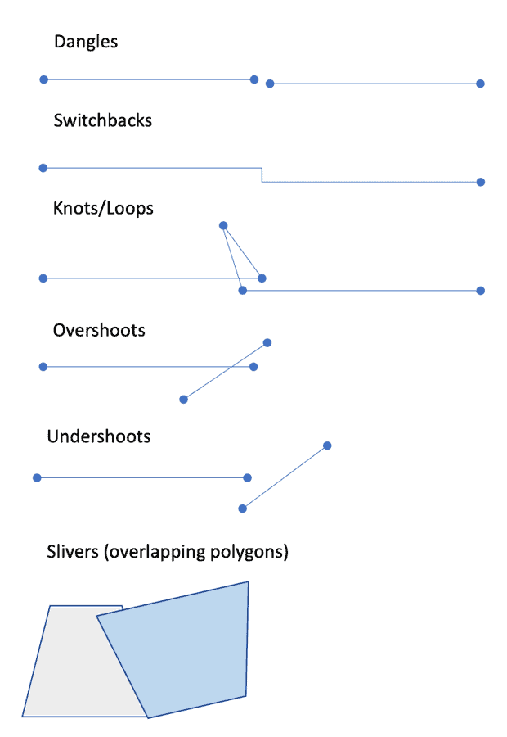
Examples of topological errors in GIS that can occur during data creation/digitization.

Slide 43
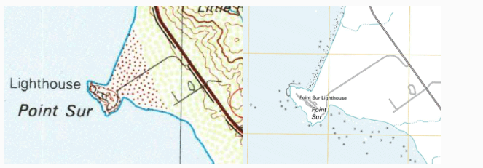
Generalization of GIS data
Figure Generalization reduces the amount of spatial detail in a GIS dataset. The 1:100000 scale USGS map on the left shows far less detail in the coastline than the 1:24000 scale map of Point Sur in California. Maps; USGS Topo maps.

Slide 44
Error Modeling

Slide 45
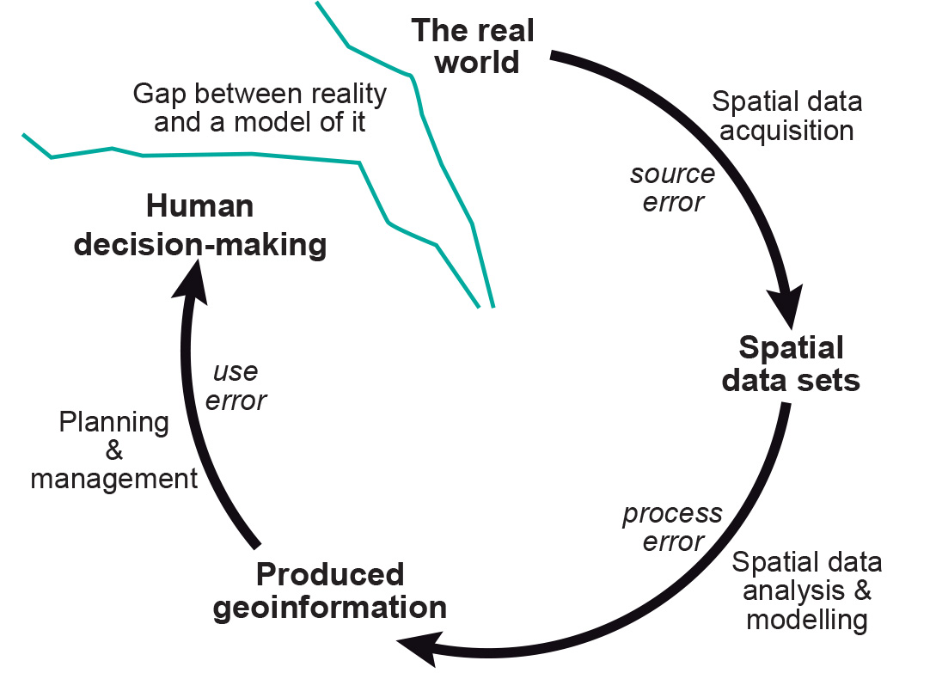
Error Modeling
Error propagation in spatial data handling

Slide 46
Quantifying error propagation
We will never be able to capture and represent everything that happens in the real world perfectly in a GIS. Hence there is much to recommend the use of testing procedures for assessing accuracy. Various perspectives, motives and approaches for dealing with uncertainty have given rise to a wide range of conceptual models and indices for the description and measurement of error in spatial data. All these approaches have their origins in academic research and have solid theoretical foundations in mathematics and statistics. Here we identify two main approaches for assessing the nature and amount of error propagation:
testing the accuracy of each state by measurement against the real world; and
error propagation modelling, either analytically or by means of simulation techniques.

Slide 47
Some common sources of error that may be introduced into GIS analyses
Coordinate adjustments | Generalization
- rubber sheeting/transformations | - linear alignment
- projection changes | - line simplification
- datum conversions | - addition/deletion of vertices
- rescaling | - linear displacement
Feature Editing | Raster/Vector Conversions
- line snapping | - raster cells to polygons
- extension of lines to intersection | - polygons to raster cells
- reshaping | - assignment of point attributes
- moving/copying | - to raster cells
- elimination of spurious polygons | - post-scanner line thinning

Slide 48
Some common sources of error that may be introduced into GIS analyses
Attribute editing | Data input and Management
- numeric calculation and change | - digitizing
- text value changes/substitution | - scanning
- re-definition of attributes | - topological construction / spatial indexing
- attribute value update | - dissolving polygons with same attributes

Slide 49
Some common sources of error that may be introduced into GIS analyses
Boolean Operations | Surface modelling
- polygon on polygon | - contour/lattice generation
- polygon on line | - TIN formation
- polygon on point | - Draping of data sets
- line on line | - -section/profile generation
- overlay and erase/update | - Slope/aspect determination

Slide 50
Some common sources of error that may be introduced into GIS analyses
Display and Analysis | Display and Analysis
- cluster analysis | - class intervals choice
- calculation of surface lengths | - areal interpolation
- shortest route/path computation | - perimeter/area size/volume computation
- buffer creation | - distance computation
- display and query | - spatial statistics
- adjacency/contiguity | - label/text placement

Slide 51
Assignment

Slide 52
Assignment
Take the two Geodatabase projects (National level and the Campus level) or you can also take other database if you have to perform the following tasks
assess what sort of errors are likely to occur in the management and use of the the two databases.
assess the precision and accuracy of each data
What is bias in GIS? Give examples of spatial / map bias

